Slide 1

B.Tech Project Evaluation-2, VIIIth Sem TRIP- A Complete Tourism Solution
Presented by :-
AMAN CHAUHAN (2018001310)
RAGHAV GUPTA (2018004539)
SATYAM SINGH (2018002681)
ARUN KUMAR (2018004636)
Under the Supervision of:-
( Dr. Danish Ather)
Assoc. Prof., Sharda University, Gr. Noida
DEPARTMENT OF COMPUTER SCIENCE & ENGINEERING
SCHOOL OF ENGINEERING AND TECHNOLOGY
02, April, 2022
1

Slide 2
Index:
Guide’s Approval for outcomes.
Guide’s Approval for evaluation.
Problem Statement and our solution.
Contents of the module.
Novelty.
Project Overview.
Work Distribution among team members.
Improvement from last evaluation.
Proof of acceptance.
Technologies Used.
Feasibility.
Project Modules.
Team details and Project Outcomes.

Slide 3
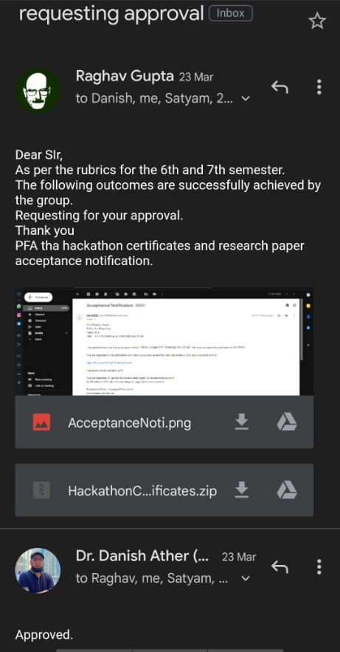
Approval from guide for the evaluation
Approval for the paper acceptance notification and hackathon certificates as expected from us by the panel members.
Both of the outcomes are approved by our guide for the final project evaluation.
Outcome’s Approval
Approved By Guide

Slide 4
Problem Definition:
Tourism can either be point of interest or need, depending on people but planning a complete itinerary for that trip is a hectic work for all. Our solution of Trip, helps a user to plan his travel in such a way so that he can manage all his tourism essentials at a single platform only.
Our Solution:
The user will be able to plan and manage all the necessary things during his visit to some place and for this he will not have to move to lot many websites and could be done at a single place.
Another important and useful thing is that user will not have to take so many itinerary apps in his phone and just have to install this single one which also saves the phone space which could be utilized for some other purposes.
The combination of mobile and web app will further solve this as if someone does not want to have an app in his phone as he occasionally does travel, then he can use the web version of the app and does all the same work from there as well.

Slide 5
Contents:
A Web App, which will allow an user to:
E-Commerce
The user will be provided with a feature to purchase useful goods during their visit.
Food
The user will be provided with a facility to order online food from nearby restaurants.
Hotel Stay
The module will facilitate its user to have a look on the local hotels for their stay with best deals.
Travel Planning
This feature can help you with the booking of your travel trains, flights, etc.

Slide 6
Novelty
What makes us different from others?
Many websites, helps in the same sector of tourism planning but the solution provided by them is a partial solution.
Our website provides complete planner at a single place rather by sites like Trivago, Booking.com, Dine-out, Airbnb and, meesho etc.
Our web app does not focuses on retail-sell market like amazon rather it provides goods and foods that is trip necessary or is famous purchasal of your planned city.
Our Future aim is to embed a city guide and planning helper, which will help you to plan your trip by recommending suggestion and tells you about the city and its important places.

Slide 7
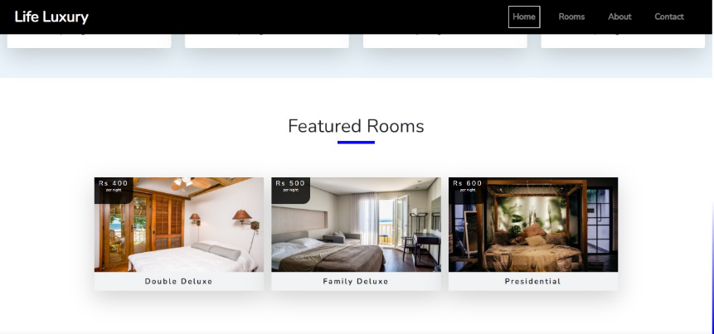
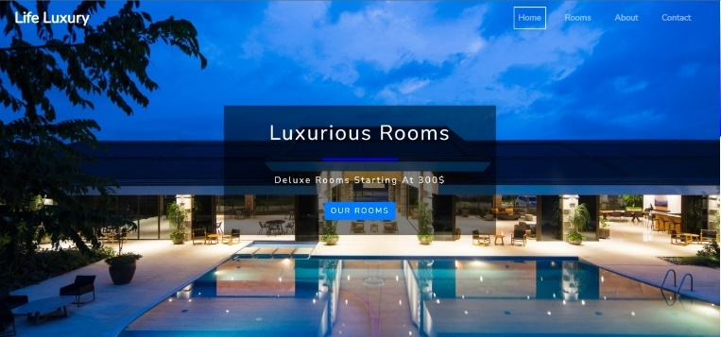
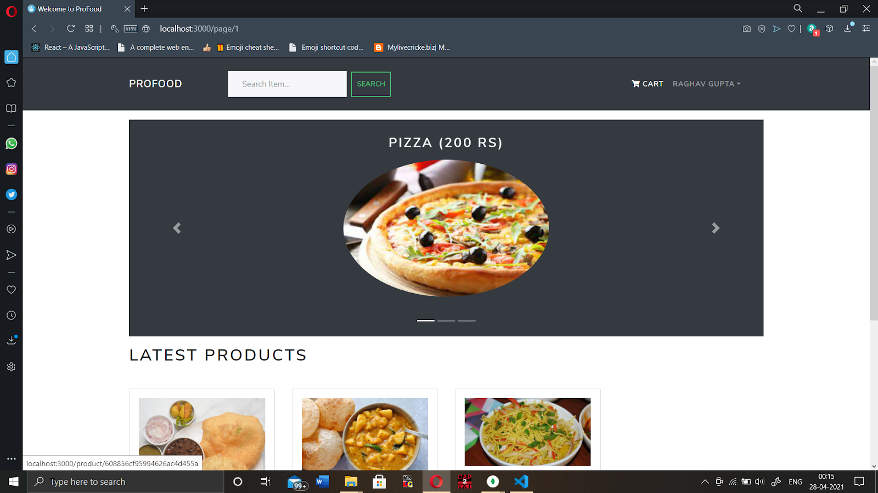
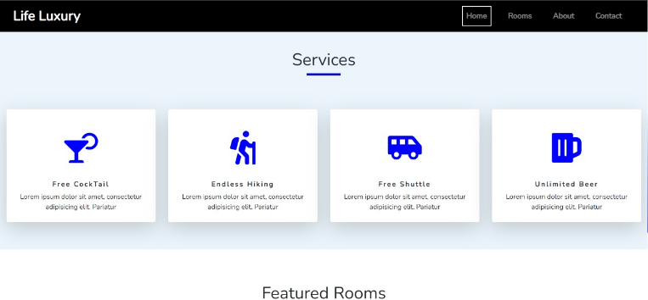
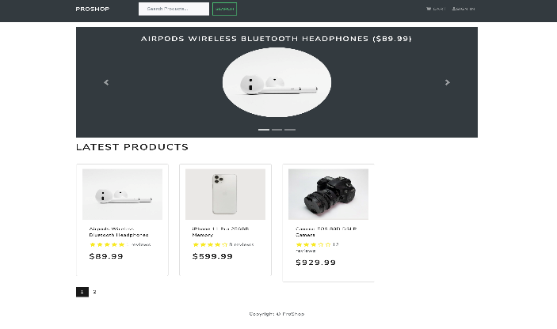
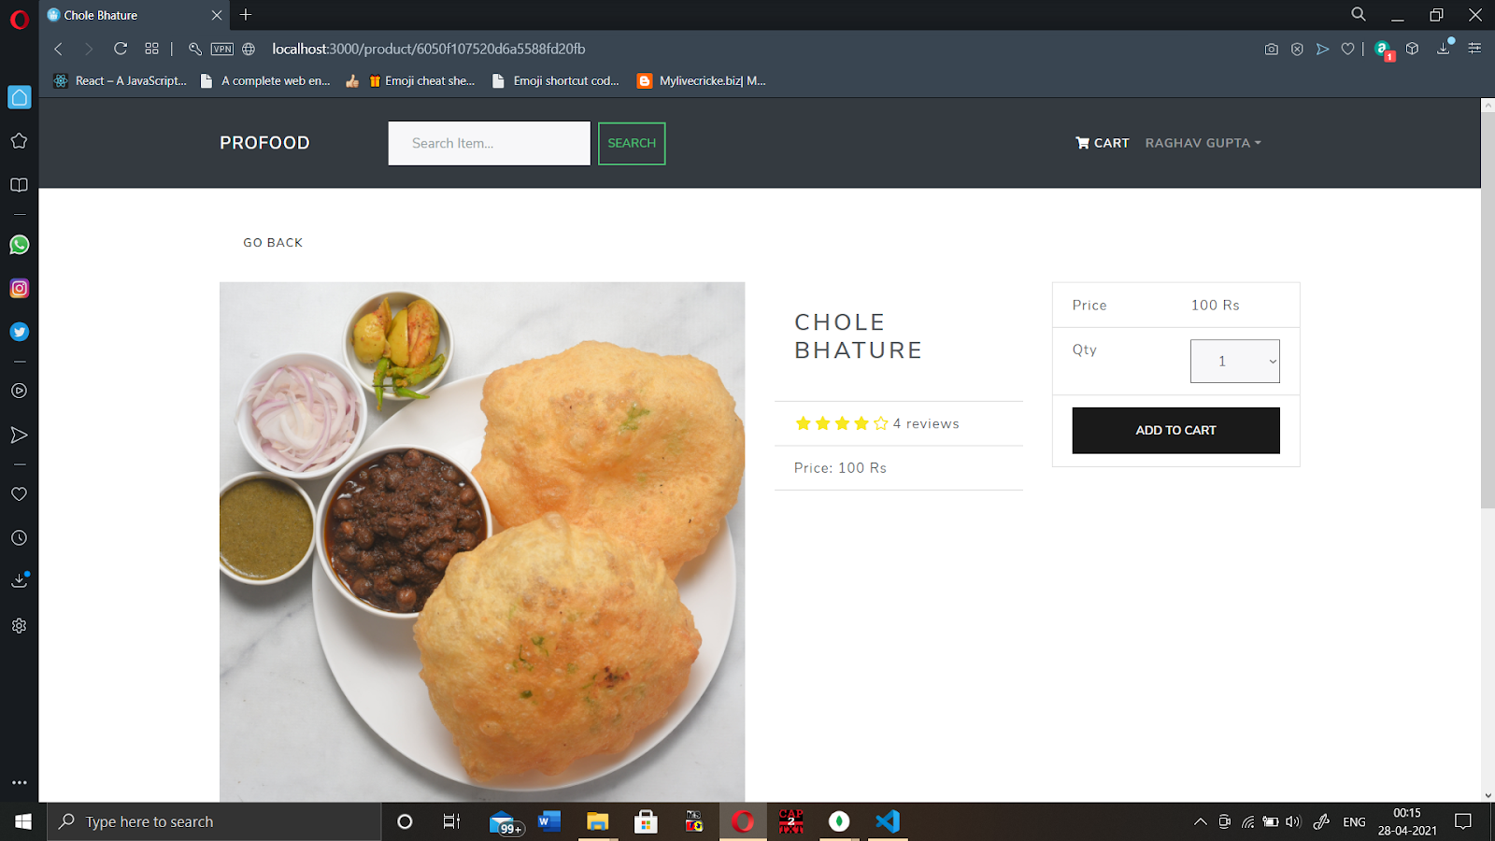
Project overview:

Slide 8
Workload distribution of the team
Name | Work
Aman Chauhan | Research Paper, Backend, Frontend
Arun Kumar | Documentation , Frontend
Raghav Gupta | Frontend , MongoDB, Backend
Satyam Singh | Hotel Management, MongoDB

Slide 9
Members | Activity Description
Raghav Gupta | Helped in the backend of the project with node.js Helped in the designing of frontend part. Helped in combining the and integration of the project.
Aman Chauhan | Helped in the backend of the project with node.js Helped in the designing of frontend part travelling Writing research paper and documentation work. Helped in integration of the project.
Satyam Singh | Helped in the backend of the project with node.js Helped in the database management with MongoDB. Helped in Hotel management frontend.
Arun Kumar | Helped in the designing of frontend part e-commerce. Helped in the designing of frontend part food. Helped in writing documentation work.

Slide 10
Improvement/Work done from the last evaluation
Received acceptance notification for the communicated research paper. The publication is yet to be done.
Got certificate of merit for the hackathon, as expected by the panel members in the last evaluation.
Completed the bus booking system for the travelling module of the Trip.
The project is just remained to be merged and is completed for the presentation and submission as a partial requirement of degree completion in the final semester of Bachelors Degree in Bachelors of Technology.

Slide 11
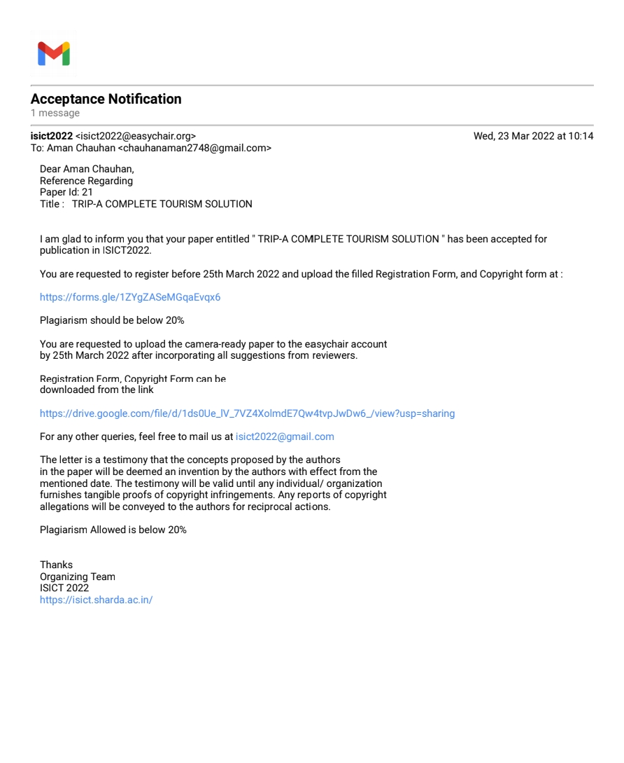
Proof of paper accepted or communicated/ Hackathon/ Patent

Slide 12
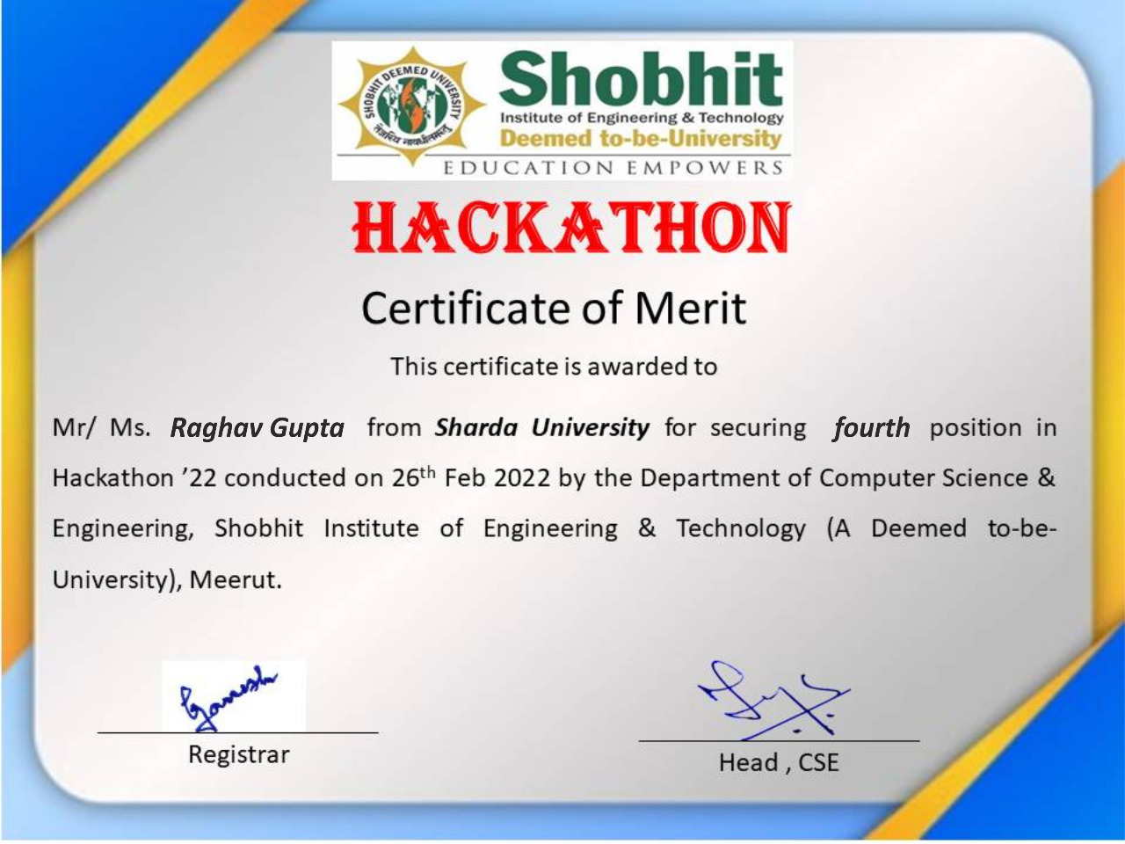




Slide 13
Technologies using:
MERN Stack: MongoDB, Express JS, React JS & NodeJS
Languages: HTML, CSS, JavaScript.
Database: MongoDB.

Slide 14
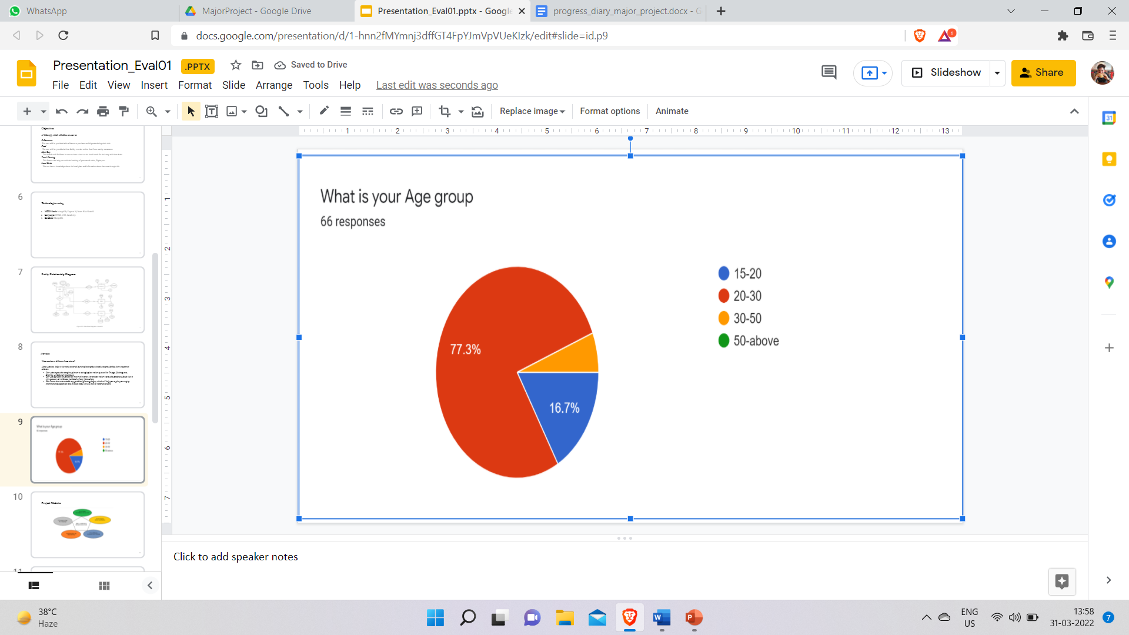
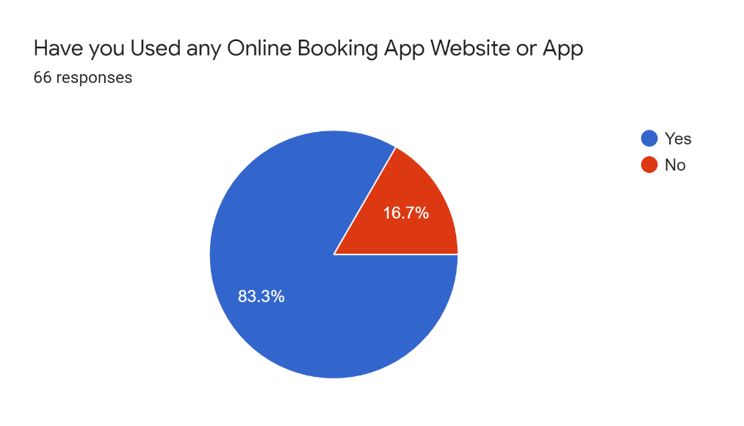
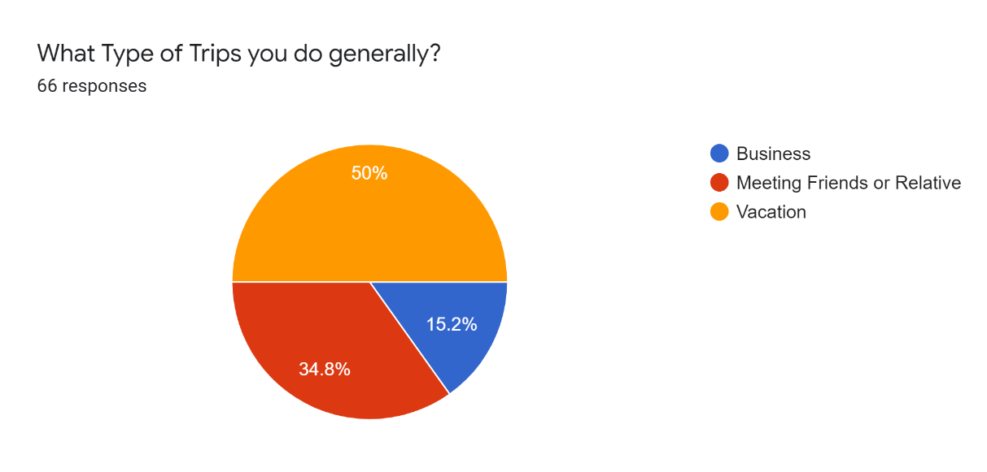
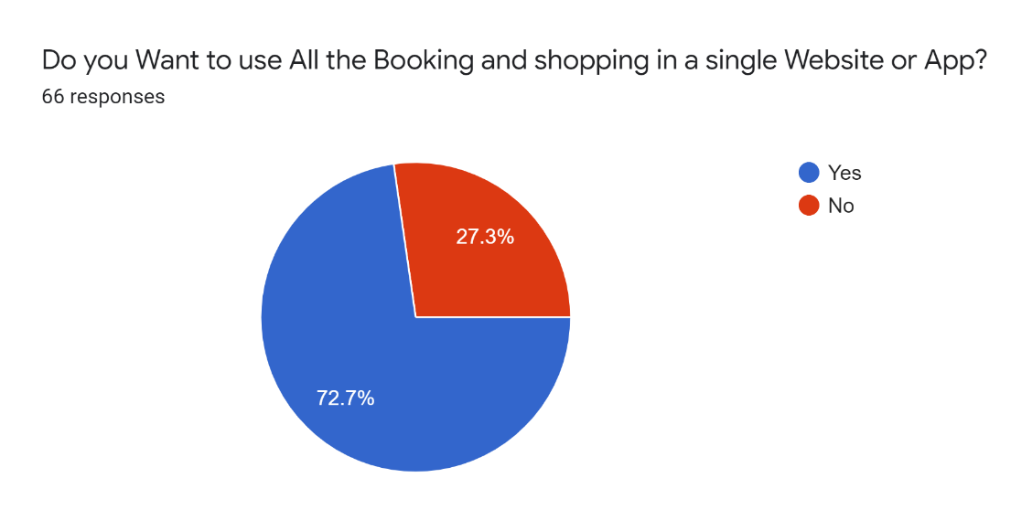
Feasibility

Slide 15
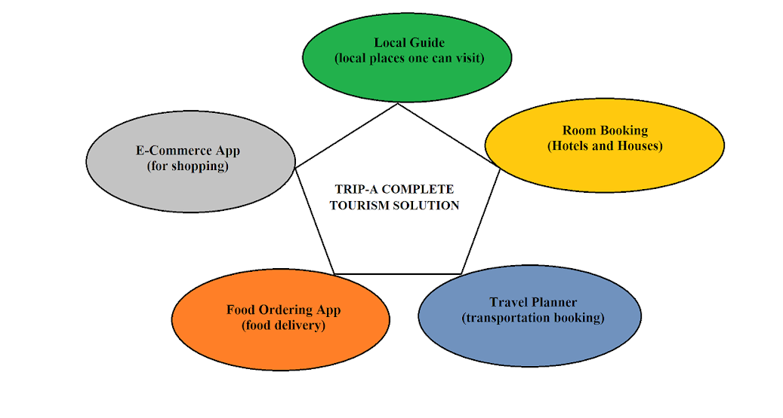
Project Modules:

Slide 16
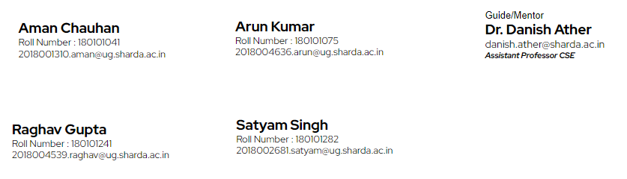
Team Details:
Project Outcomes:
Web Development
Hackathon Certificates
Research Paper submitted to ICIPTM2022-IEEE

Slide 17
Thanking You, for your time and anticipation

